Slide 1
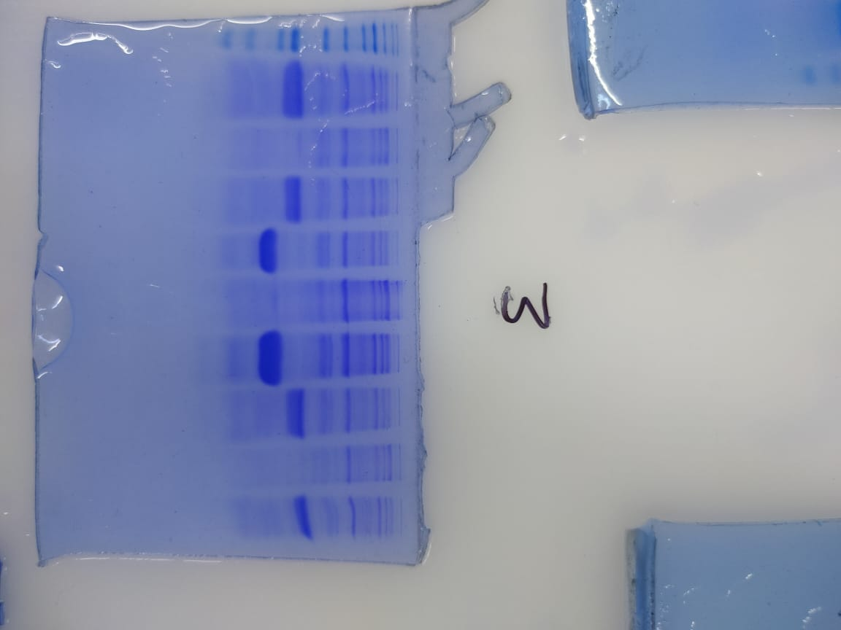
Lane
1 – Ratnesh
2 - Uninduced sample
3 – Pratham
4 – Mayank
5 – Uninduced sample
6 – Dhwani
7 – Shubham
8 – Uninduced sample
9 - Rishita
10 – Protein ladder
1 2 3 4 5 6 7 8 9 10
25 kDa
18 kDa

Slide 2
Lane
1 – Ratnesh
2 - Uninduced sample
3 – Pratham
4 – Mayank
5 – Uninduced sample
6 – Dhwani
7 – Shubham
8 – Uninduced sample
9 - Rishita
10 – Protein ladder
1 2 3 4 5 6 7 8 9 10
25 kDa
18 kDa

Slide 3
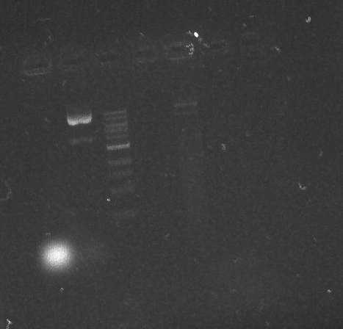
Ladder
Genomic DNA and plasmid
Ratnesh
Genomic
DNA
Mayank
Genomic
DNA
Ratnesh
Plasmid
Mayank
Plasmid
Plasmid was Observed.
Genomic DNA was absent.
RNA

Slide 4
Ladder
Genomic DNA and plasmid
Ratnesh
Genomic
DNA
Mayank
Genomic
DNA
Ratnesh
Plasmid
Mayank
Plasmid
Plasmid was Observed.
Genomic DNA was absent.
RNA

Slide 5
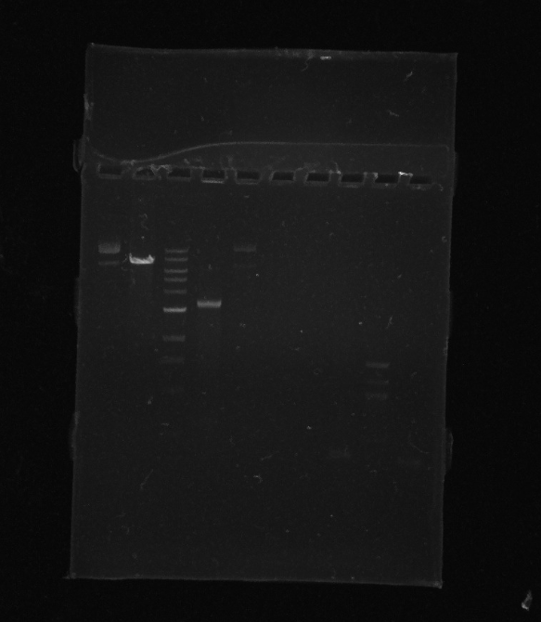
Ladder
Ratnesh
Mayank
Ladder
Restriction digestion and PCR product
Ratnesh
Mayank
PCR product
was observed
undigested
plasmid
digested plasmid
digested
plasmid
undigested
plasmid

Slide 6
Ladder
Ratnesh
Mayank
Ladder
Restriction digestion and PCR product
Ratnesh
Mayank
PCR product
was observed
undigested
plasmid
digested plasmid
digested
plasmid
undigested
plasmid

Slide 7
Ladder
Ratnesh
Mayank
Ladder
Restriction digestion and PCR product
Ratnesh
Mayank
Gel elution part
PCR product
was observed
undigested
plasmid
digested plasmid
digested
plasmid
undigested
plasmid

Slide 8
Ladder
Ratnesh
Mayank
Ladder
Restriction digestion and PCR product
Ratnesh
Mayank
Gel elution part
PCR product
was observed
undigested
plasmid
digested plasmid
digested
plasmid
undigested
plasmid

Slide 9
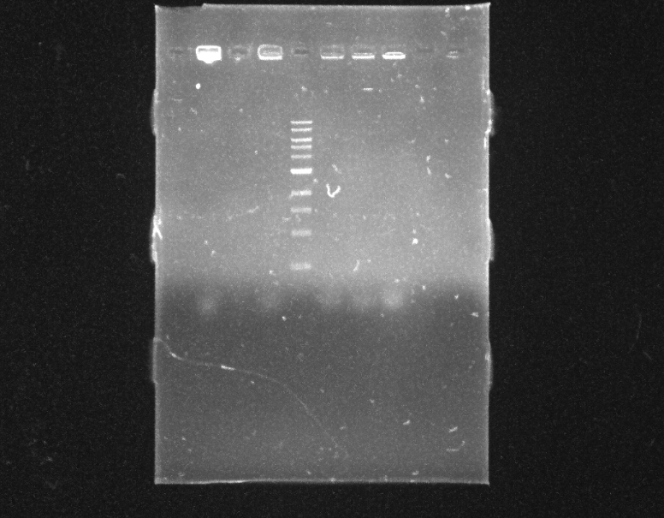
Colony PCR
Ratnesh
Mayank
Dhwani
None of us observed the ligation of insert into vector.

Slide 10
Colony PCR
Ratnesh
Mayank
Dhwani
None of us observed the ligation of insert into vector.

